Slide 1

Discovery of the Once-Weekly GLP-1 Analogue Semaglutide
November 16th, 2025
Journal Club Presentation | BEC 575 | Lola Olosu

Slide 2
Table of Contents
Background & Clinical Need
Materials & Methods
Design & Strategy
Key Findings
Conclusion & Analysis

Slide 3
01.
Background and Clinical Need

Slide 4
Global Disease Burden
Problem
Type 2 diabetes & obesity are chronic, progressive metabolic diseases
~537 million adults affected worldwide; prevalence continues increasing
Strongly associated with cardiovascular disease, kidney failure, NAFLD & reduced lifespan
Now and What’s Needed
Therapeutic need: durable, potent, and patient-friendly dosing strategy
Long-term multi-drug regimens → low adherence & treatment fatigue

Slide 5
Biology & Therapeutic Potential of GLP-1
GLP-1 = incretin hormone released from gut after meals
Enhances glucose-dependent insulin secretion, reduces glucagon
Slows gastric emptying, suppresses appetite, promotes weight loss
Demonstrates cardiometabolic benefits beyond glycemic control
GLP-1 receptor agonism is a clinically validated therapeutic mechanism

Slide 6
Why Native GLP-1 Is Not Therapeutically Viable
Extremely short plasma half-life (~1–2 minutes)
Rapid enzymatic cleavage by DPP-IV at position 8
Fast renal clearance due to small size & hydrophilicity
Cannot achieve therapeutic exposure without modification
Need engineered analogue with stability + PK extension

Slide 7
02
Materials & Methods/Design

Slide 8
Therapeutic Engineering Goals
Primary objective: Develop a once-weekly GLP-1 receptor agonist with retained biological function
Engineering requirements:
Protease resistance: avoid rapid DPP-IV degradation at Ala8
Reduced renal clearance: prolonged circulation time
Preserved receptor potency & signaling profile
Balanced hydrophobicity: avoid aggregation or loss of activity
Scalable & manufacturable chemical design

Slide 9
Why Lys26 + Linker Are Critical
Lysine ε-amine is highly nucleophilic → ideal conjugation site
Site must be solvent-exposed and outside receptor-binding region
Screening revealed Lys26 preferred over other lysines
γ-Glu-2xOEG linker ensures proper chain length & flexibility
Prevents steric hindrance, retains receptor signaling capacity
Enables optimal albumin-binding orientation

Slide 10
03
Design & Strategy

Slide 11
Design Strategy
Amino-Acid
Substitutions
Identification of Optimal Conjugation SIte
Enhance protease resistance
Lys26 selected
Insertion of custom linker spacer
Attachment of C18 fatty acid
Maintain structural flexibility
Promote albumin binding & slow clearance

Slide 12
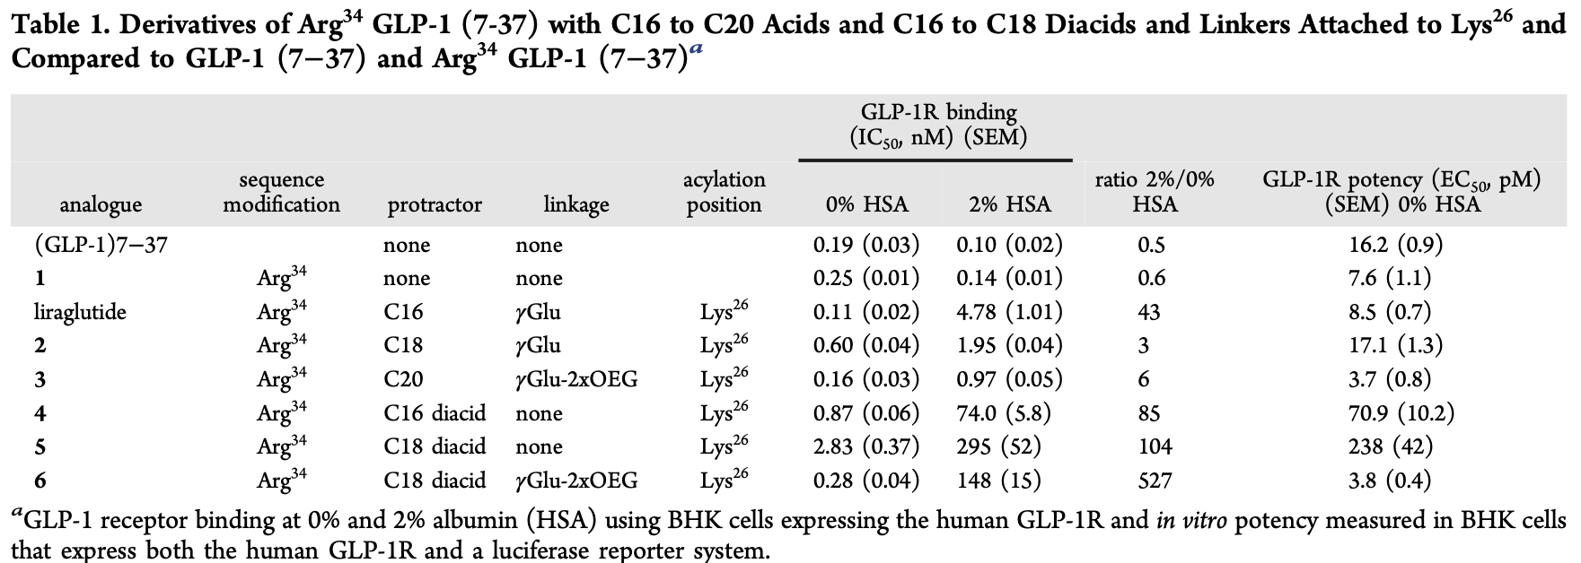
Analog Modifications

Slide 13
Experimental Workflow & Screening Strategy
Multi-stage optimization pipeline:
Peptide variant generation (amino acid substitutions + conjugation variants)
In vitro screening:
  DPP-IV proteolysis assays
  GLP-1R signaling potency assays
Albumin-binding evaluation (ligand-binding + biophysical affinity tests)
Pharmacokinetics profiling in animals:
  Rodent & non-human primate models
  Half-life, exposure, clearance
In vivo metabolic efficacy:
  Glucose tolerance
  Body-weight response

Slide 14
04
Key Findings

Slide 15
Key In Vitro Screening Results
DPP-IV resistance significantly improved by Aib substitution at position 8
Receptor agonist potency retained in most engineered analogues
Trade-off observed: Some modifications increased stability but reduced GLP-1R activity
Goal: identify variants that pair stability with full signaling efficacy

Slide 16
Albumin Binding vs Potency: SAR Optimization
Fatty-acid conjugation increases albumin binding → slows renal clearance
Linker length & composition directly influence potency and PK
Too strong albumin binding ≠ optimal → may reduce receptor engagement
Lys26 + γ-Glu-2xOEG + C18 tail identified as optimal SAR configuration
Achieved balanced albumin affinity + preserved signaling potency
Design Variant | Albumin Affinity | Potency | Outcome
Short Linker | High | ↓↓↓ | Not Viable
Long Linker | Moderate | ↓↓ | Sub-Optimal
Optimized linker (final) | Ideal | Maintained | Selected Candidate

Slide 17
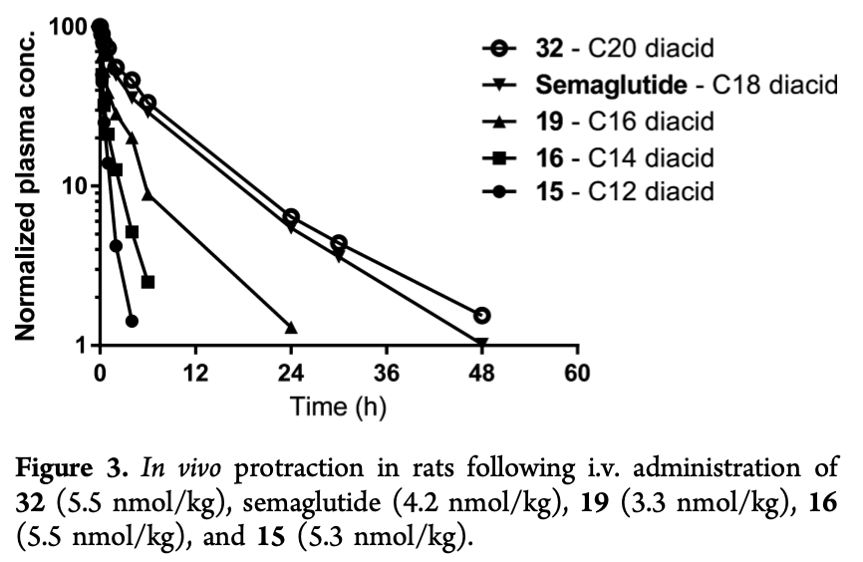
Showing Therapeutic Success

Slide 18
In Vivo Pharmacokinetics & Metabolic Efficacy
Engineering success = optimal half-life without compromising efficacy!
Achieved once-weekly pharmacokinetic profile
Half-life significantly extended vs native GLP-1 & liraglutide
Demonstrated dose-dependent glucose control in rodent & primate models
Maintained sustained pharmacodynamic effect with reduced dosing frequency
Supports clinical translation potential → semaglutide

Slide 19
06
Conclusions & Analysis

Slide 20

Overall Conclusion
Rational molecular engineering successfully produced a once-weekly GLP-1 analogue
Combined Aib8 + Arg34 substitutions and Lys26-linked C18 fatty acid produced optimal profile
Achieved enhanced protease resistance, albumin-mediated PK extension, and preserved GLP-1R activity
Demonstrated strong in vivo metabolic efficacy and translational potential
Research culminated in semaglutide, now a globally impactful metabolic therapeutic

Slide 21
Broader Therapeutic & Scientific Impact
Semaglutide is now part of standard-of-care in diabetes & obesity
Redefined dosing expectations for metabolic therapies
Demonstrates platform potential for peptide half-life engineering
Research helped establish structure–PK–efficacy design principles
Success accelerated development of next-generation analogs (e.g., tirzepatide, retatrutide, oral semaglutide)

Slide 22
Critical Analysis: Strengths
Strong aspects of the study:
Rational, stepwise SAR-driven approach rather than empirical screening
Mechanistically justified modification strategy
Evaluated multiple performance domains (stability, potency, PK, efficacy)
Clear translational relevance and clinical feasibility
Strong alignment between hypothesis, data, and outcome

Slide 23
Critical Analysis: Limitations & Open Questions
Limited early assessment of immunogenicity & long-term stability
Albumin-binding mechanism not structurally confirmed (model-based only)
Manufacturing and formulation challenges not fully addressed
Linker/lipid modifications may influence aggregation or solubility
Future opportunity: detailed mechanistic structural biology (cryo-EM/NMR)

Slide 24
References
Primary Article
Lau, J., Bloch, P., Schäffer, L., Pettersson, I., Spetzler, J., Kofoed, J., et al. (2015). Discovery of the once-weekly glucagon-like peptide-1 (GLP-1) analogue semaglutide. Journal of Medicinal Chemistry, 58(18), 7370–7380. doi:10.1021/acs.jmedchem.5b00726
Supporting References
Knudsen, L. B., & Lau, J. (2019). The discovery and development of liraglutide and semaglutide. Frontiers in Endocrinology, 10, 155. doi:10.3389/fendo.2019.00155
Buckley, S. T., Bækdal, T. A., Vegge, A., Maarbjerg, S. J., Pyke, C., Ahnfelt-Rønne, J., et al. (2018). Transcellular stomach absorption of a derivatized GLP-1 peptide enabled by an absorption-enhancing excipient. Science Translational Medicine, 10(467), eaar7047. doi:10.1126/scitranslmed.aar7047
Rosenstock, J., Allison, D., Birkenfeld, A. L., Lam, C. S. P., Capehorn, M., Bruno, A., et al. (2021). Effect of once-weekly semaglutide on weight loss in adults with overweight or obesity. New England Journal of Medicine, 384, 989–1002. doi:10.1056/NEJMoa2032183

Slide 25
THANKS
DO YOU HAVE ANY QUESTIONS?

